Slide 1
Twenty Years After Deinstitutionalisation Current Trends in Services for People with Intellectual Disabilities in Norway
Jan Tøssebro
NTNU Social Research
Trondheim, 20 June 2013

Slide 2
Structure of presentation
Conclusions:
A need to rekindle the ideological drive
Governing structures for a “sustainable” development?
Point of departure – trends
The second wave of normalization (1990s)
move towards full deinstitutionalization – first country to close all inst.
move towards generic services run by local government
The litmus test: what happened when the reform energy faded
Understanding recent trends: external developments
The exposure to trends & problems in local government
Changing structures of local government and the conditions for change agents

Slide 3
Background I: The fall of institutions in Norway, 1988-1998

Slide 4
Background Ib: The fall of institutions Norway, 1960-1998

Slide 5
Replacing institutions, Nordic Countries People per 1000 inhabitants, Source: Tøssebro et al. 2012

Slide 6
Data sources:
Interviews with staff on the living conditions of individuals with intellectual disabilities (people aged 18/20 to 67)
1989 (pre reform) (N=396) (living in institutions in three counties)
1994 (post reform) (N=396) (same people after resettlement in the community)
2001 (N=527) (people with community services in 53 municipalities (about 10% of the pop.))
2010 (N=385) (people with community services in 53 municipalities)
Questionnaires to families the same years for the same people

Slide 7
Profile of Scandinavian research
Profile:
Means approach:
Changes in adaptive behaviour?
Values approach:
The value of normalisation taken for granted
Does it happen or is old structures reproduced
Frame of reference:
Compared to institutions
Compared to other people/welfare state values

Slide 8
Main results from “the 1989-1994 evaluation”
Family attitudes: from opposition to support
Support increases from 17 to 76 per cent
Much improved housing conditions
More self-determination/ choice in everyday matters
“On my street”
neighbour reactions, community presence
More people with services
2.4 per 1000 inhabitants in 2000 (up from 1.5)
Leads to increased pressure on costs
The revolution that disappeared
occupation, social networks, leisure, etc.

Slide 9
Housing conditions 1994
82% moves into a full personal rented apartment
6% lives semi-independent, others in group homes
Group size (number in the house) of 3-4 (mean 3,7)
Mean private space: 48 square meters (450 sq. feet?)
18% without full flat
Housing is not just standard:
Family: «feels more like a visit to my son or daughter»
Staff: conflicts and negative relations among residents reduced

Slide 10
Developments after the mid 1990s – living arrangements
Group homes where the individual does not have a full flat disappears
Number living semi-independently increases to 20% by 2000, but has not changed since.
Revolving door staff more typical.
The size of group homes increases substantially (sometimes in the shape of reinstitutionalisation?)
Mixed groups (intellectual disability and mental health problems) becomes more typical

Slide 11
Changing living arrangements

Slide 12
Developments after the mid 1990s – other life domains
Fewer people have daytime activity, and occupation is less according to the principles of normalisation
From 5 to 16% without occupation
Reduction in supported and sheltered employment
Day centres less “work-like”
Self-determination is reduced, and “routines” and “staff working hours” are more often referred to as reasons for restrictions in choice
Social network – no change
Leisure activity/ integration increases

Slide 13
Developments before the 1990s: Nothing happened?

Slide 14
Staff: user ratio 1950-89 Source: Tøssebro, 1992.
Notes:
Jeg skal vise noen kurver som illustrerer utviklingen, uten å gå i detalj.
Den føste viser antall ansatte per bruker. Etter at det har ligget på omtrent det samme siden 1920, skjer det noe fra tidlig på 1960-tallet og det skyter fart på 70-tallet. Det skjer sammen med ideer om en mer aktiv omsorg, og økt kritikk av levekårene – Sosialkomiteens besøk på Klæbu, offentlige utredninger (Lossius I) og skandaleoppslag i pressen. Ikke minst var den kjente filmregissøren og spaltisten Arne Skouen aktiv.

Slide 15
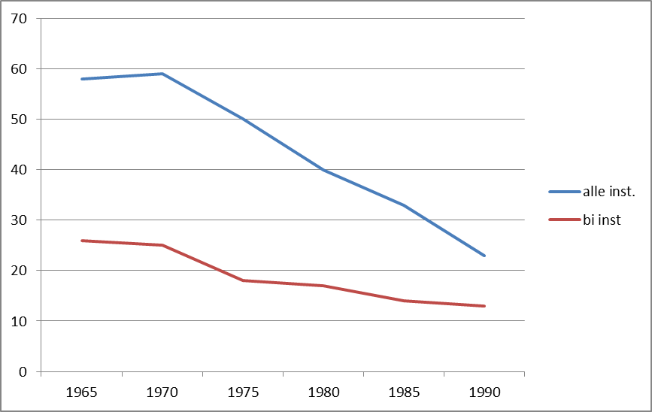
Number of people per institution, 1965-88 Souce: Tøssebro 1992
Notes:
Etter 1965 har det vært en kontinuerlig bevegelse mot mindre enheter, med begrunnelse i å normalisere livsforholdene men også «den lille gruppens prinsipp» - argumenter om forholdet mellom størrelse og omsorg som særlig knyttes til nestoren i svensk omsorg for utviklingshemmete – Karl Grunewald.
Begrunnelsen hans knyttet særlig an til gruppepsykologi – hva skjer med ansvar og relasjoner når en gruppe blir stor – jf Michael Moore og ansvar for en som ligger på gata i Toronto, NY og London. Dette er vist i alle slags grupper.
Et annet argument knytter mer til normalisering og poenget med at enheter skal ha «husholdsstørrelse» og gi «normale» utad og innad stimuli.
Utviklingen skjer dels ved etablering av mange nye institusjoner i lokalområdet, men også at sentralinstitusjonene ble mye mindre. Den største, Klæbu pleiehjem hadde 500 senger, mens Hallsetheimen mot slutten hadde 190 brukere fordelt på hus med stort sett 5-8 beboere.
Størrelsen går ned med to tredeler fra 1965 til 1988.
Gjennomsnittstørrelsen på bi-institusjoner var 13 brukere i 1989, og mange hadde færre enn ti – faktisk det meste etablert på 80-tallet.

Slide 16
Economic growth compared to all health inst. Adjusted for GNP changes (100) Source: Tøssebro 1992
Notes:
Denne illustrerer tilførselen av økonomiske ressurser fra 1973 til 87.
Ellers kan jeg nevne – snitt avdelingsstørrelse ned fra 23 til 7, mye mer opplæring og dagaktivitet, inkludert aktivitetsbygg
Andelen med eget rom økte fra en av åtte til alle. (gjelder 1971-1989)
Så når Lossiusutvalget i 1985 konkluderer med at det har skjedd lite, gjelder det institusjonsavvikling og utbygging av alternativ til institusjon, men innen HVPUs vegger skjedde det mye.
Men viss det skjedde så mye – hvorfor da denne reformen? Intensjonene var at det skulle skje mye mer, og på andre premisser, egentlig en revisjon av målestokk, hvem en sammenlignet med
– og det var foreløpig endepunkt for en debatt om omsorg og institusjoner som hadde gått siden 1960-tallet.
Det får være nok illustrasjon av utviklingen, la oss se på debatten – eller rettere sagt konteksten eller forløperne til reformens visjoner.

Slide 17
Preliminary conclusions:
Deinstitutionalisation was a quantum leap in living conditions, in particular regarding
Housing conditions
Community presence
More people with services
But – the quantum leap made an end to a long term positive development

Slide 18
Why? How come?
Changing values/policies? No
Less media/ political attention? No doubt
Decreasing media attention
Central government
Decreasing attention
Less monitoring
Phasing out of specific funding programmes and regulations
New items on the disability policy agenda
The explicit arguments?
Loneliness – not true
Professional environment and staff stability – the other way around
Costs – uncertain
The need to provide services to more people
Governing structures and changing drivers of change?

Slide 19
Background II: The second reform (Nordic)
Level of government:
1960-70s: From a state/NGO mix to regional health authorities (counties, care districts)
1990s and beyond: Local (municipal) government responsible for services
Legislation:
Gradually since the 1970s: from special to general legislation
Exception Sweden with a special rights legislation for people with severe disabilities

Slide 20
The reform context (Norway): National policy
A national reform decided by the parliament
Mandatory closure of all institutions
Strong normalization ideology
Decent living conditions according to typical standards
Housing regulations
Generic services
Should provide the foundation for a new and better development of services – a new trajectory
Housing must be solved immediately
Some ideals must be fulfilled over time (occupation, leisure, services to more people)

Slide 21
The new context: Local government implementation
Municipalities are the core service provider.
The principle of local autonomy: central government regulations tuned out (earmarking, housing regulations, monitoring)
Exposure to general trends in local government policies, priorities and administration
Some families feared this, but in general it was widespread optimism and the attitude that “we are going to do this, and do it well”

Slide 22
Changes in local government – New public management
Managerialism
Efficiency
Economic accountability
Sector interests less legitimate
Indirect control
Role of politician – strategy rather than details
Marketization
Bench-marking
User/consumer focus
Choice
Consumer surveys

Slide 23
Drivers of change in the 1980-90s
User organizations, with
Allies among national policymakers
Allies in national public administration
Professionals (mainly watchdog role during implementation)
Inspiration from countries that were early in resettling people from institutions

Slide 24
The new local government – processed in the garbage can
User choice - stakeholder participation
User organisations weak at the local level
The individual choice context: “Take it or leave it”
Professional staff
From professional to employee – voice vs. loyalty
Purchaser – provider split
The role of the politician
“The devil is in the details”
De-involvement
Bench-marking
Yardstick changed from “international inspiration” to “municipalities providing with cheaper service models”

Slide 25
Concluding remarks
The reform of the 1990s was a quantum leap
We see the termination of a long term positive development
There is a move from ideology to silence
The policy context has changed from expanding the welfare state to local government economic accountability
The earlier drivers of change has lost power

Slide 26
Challenges
To rekindle the ideological drive
Renewed media attention 2011-12 appeared to help but is back in silence now
To set up a sustainable governance structure
A structure that works during years of little attention
For a group that tend to be of low priority in non-reform years
Not relying on “grey panthers”
How: please tell us!
Some of the structures from the 1990s would probably help

Slide 27
Decentralization was hardly a failure, but the transfer of responsibility to the everyday business of local governments requires an ideological drive, political accountability and also safe-guarding measures or regulations

Slide 28
Further information:
Jan Tøssebro , Inge S. Bonfils, Antti Teitinen, Magnus Tideman, Rannveig Traustadóttir & Hannu Vesala:
Normalization Fifty Years Beyond – Current Trends in the Nordic Countries, Journal of Practice and Policies in Intellectual Disabilities, 9: 134-146, June 2012
Jan.tossebro@ntnu.no

